Slide 1
TITLE: L-BFGS OPTIMIZATION IN CLASSIFICATION MODEL (IRIS DATASET USING SCIKIT-LEARN)
PRESENTED BY: TEAM MEMBERS:
MD HAJEK ANJUM BENOY
ID:2102046 REG:10173
MD NOUSHAD BHUIYAN
ID:2102038
REG:10165

Slide 2
CONTENT
Objective: To explore how L-BFGS is used in classification problems.
Tool: Scikit-learn’s Logistic Regression
Dataset: Iris Dataset
Focus: Optimization method — L-BFGS

Slide 3


L-BFGS stands for Limited-memory Broyden–Fletcher–Goldfarb–Shanno.
It is an optimization algorithm used to minimize a loss function.
Belongs to the Quasi-Newton family.
Efficient for problems with a large number of parameters.
Commonly used in logistic regression, neural networks, and other ML models.
What is L-BFGS?

Slide 4
Why Use L-BFGS?
HANDLES LARGE PARAMETER SPACES EFFICIENTLY.
MORE STABLE AND FASTER CONVERGENCE THAN BASIC GRADIENT DESCENT.
REQUIRES LESS MEMORY THAN FULL BFGS (LIMITED-MEMORY).
IDEAL FOR LOGISTIC REGRESSION WITH DENSE DATA.

Slide 5
150 SAMPLES OF IRIS FLOWERS
3 CLASSES: SETOSA, VERSICOLOR, VIRGINICA
4 FEATURES:
1.SEPAL LENGTH
2.SEPAL WIDTH
3.PETAL LENGTH
4.PETAL WIDTH
A CLASSIC EXAMPLE OF A MULTI-CLASS CLASSIFICATION PROBLEM
THE IRIS DATASET

Slide 6
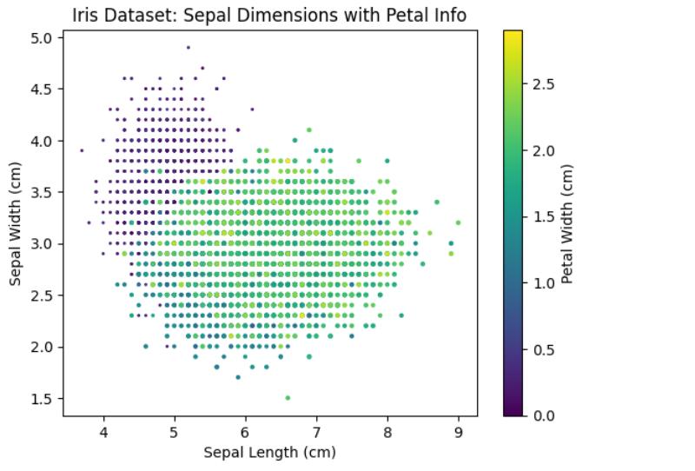
ScatterPlot:
Split Data:
x= df.iloc[:,0:4] y=df.iloc[:,-1]
Distinguish Train and Test Data:
x_train,x_test,y_train,y_test=train_test_split(x,y,test_size=0.1)

Slide 7
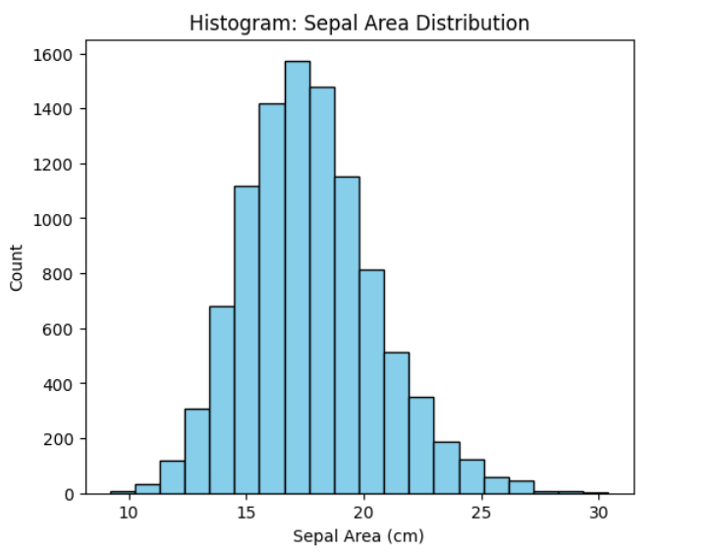

Slide 8
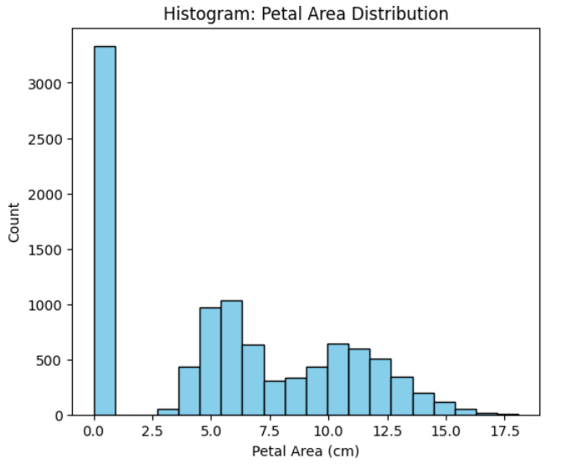

Slide 9
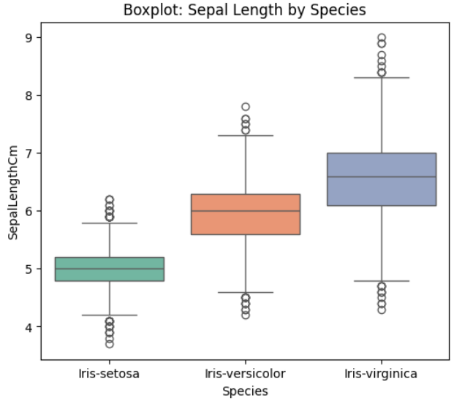

Slide 10
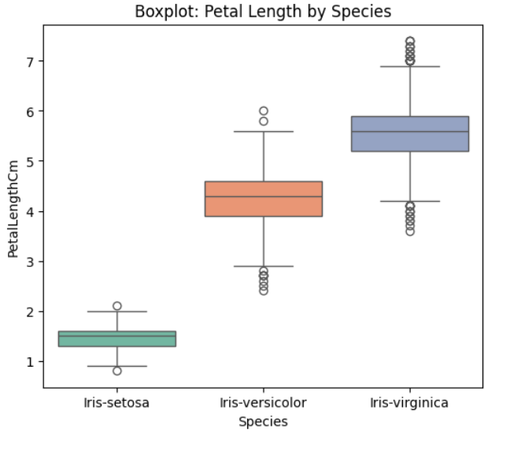

Slide 11
Train Dataset Code:
from sklearn.preprocessing import StandardScaler
scaler= StandardScaler()
x_train=scaler.fit_transform(x_train)
x_test=scaler.transform(x_test)
from sklearn.linear_model import LogisticRegression
clf=LogisticRegression()
clf.fit(x_train,y_train)

Slide 12
Engagement data
y_test | y_train | Accuracy
Iris-versicolor | Iris-versicolor
Iris-setosa | Iris-setosa
Iris-setosa | Iris-setosa | 0.994
Iris-virginica | Iris-virginica
Iris-virginica | Iris-virginica
Iris-virginica | Iris-versicolor

Slide 13
99.4%
ACCURACY OF AI MODEL
CODE:FROM SKLEARN.METRICS IMPORT ACCURACY_SCORE

Slide 14
SUMMARY
L-BFGS IS A POWERFUL OPTIMIZER FOR LOGISTIC REGRESSION
SCIKIT-LEARN MAKES IMPLEMENTATION EASY AND EFFICIENT
IRIS DATASET PROVIDES A CLEAR, INTERPRETABLE CLASSIFICATION EXAMPLE
VISUALIZATION HELPS IN UNDERSTANDING MODEL PERFORMANCE

Slide 15
THANK YOU FOR YOUR ATTENTION!
FEEL FREE TO ASK QUESTIONS OR REQUEST A CODE DEMO.
Q&A

